Slide 1

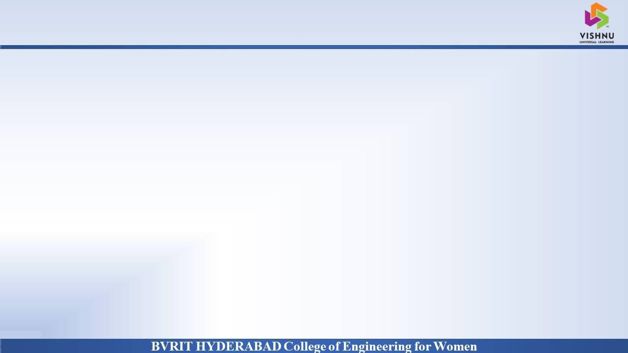
Department of Computer Science and Engineering
Survival Of Heart Failure Prediction Using Feature Scaling
Date: 13 May 2021
SHAMINI : 17WH1A0556
TRIPURA : 17WH1A0521
NITHYA SRI : 17WH1A0503
Internal Guide : Ms. Naga Kalyani Designation : Assistant Professor

Slide 2


Abstract
Why Should I Study this course?
Examples
BVRIT HYDERABAD College of Engineering for Women
Problem Statement:
To predict the survival of heart failure patients using biomedical data collected from Faisalabad Institute of Cardiology and at the Allied Hospital in Faisalabad.
Project Objective:
Heart failure prediction can be an effective tool, both to predict the survival of each patient having heart failure symptoms and to detect the most important clinical features (or risk factors) that may lead to heart failure.

Slide 3

DATASET
Why Should I Study this course?
Examples
BVRIT HYDERABAD College of Engineering for Women
Dataset Description:
Dataset consists of 13 features and 299 instances of biomedical record of heart failure patients collected at the Faisalabad Institute of Cardiology and at the Allied Hospital in Faisalabad (Punjab, Pakistan), during April–December 2015.
Attribute | Description | Attribute | Description
Age | Age of the patient | Platelets | Platelets in the blood
Anaemia | Decrease of red blood cells or hemoglobin | Serum creatinine | Level of creatinine in the blood
High blood pressure | If a patient has hypertension | Serum sodium | Level of sodium in the blood
Creatinine phosphokinase | Level of the CPK enzyme in the blood | Smoking | If the patient smokes
Diabetes | If the patient has diabetes | Time | Follow-up period
Ejection fraction | Percentage of blood leaving the heart at each contraction | death event | If the patient died during the follow-up period
Sex | Woman or man

Slide 4
ARCHITECTURE
Why Should I Study this course?
Examples
BVRIT HYDERABAD College of Engineering for Women
Data Acquisition
Applying classification algorithms
Feature scaling
Model tuning
Data interpretation
Dataset Analysis

Slide 5
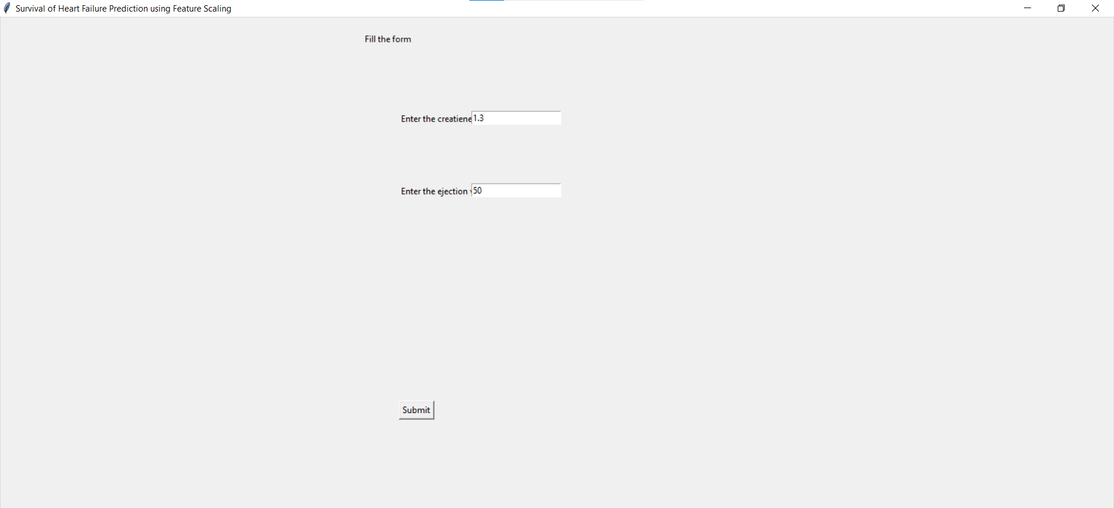
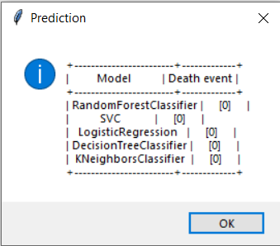
OUTPUT
Why Should I Study this course?
Examples
BVRIT HYDERABAD College of Engineering for Women

Slide 6
Technology Stack
Why Should I Study this course?
Examples
BVRIT HYDERABAD College of Engineering for Women
Supervised Machine Learning
Python Language
Libraries Used:
sklearn
pandas
numpy
tkinter

Slide 7
System Requirements
Why Should I Study this course?
Examples
BVRIT HYDERABAD College of Engineering for Women
ENVIRONMENT | SPECIFICATIONS
HARDWARE | Processor - Intel Core i5 Memory(RAM) - 8 GB Storage – I TB
SOFTWARE | Python OS - Windows 10 Google Colab Pycharm

Slide 8
Timeline
Why Should I Study this course?
Examples
BVRIT HYDERABAD College of Engineering for Women
REVIEW 0 | Software Requirements Data Cleaning
REVIEW 1 | Data Preprocessing Feature Ranking Implementation of algorithms
REVIEW 2 | Comparison of algorithms Design UI part
REVIEW 3 | Complete implementation Results & Discussions Project Report Draft

Slide 9
References
Why Should I Study this course?
Examples
BVRIT HYDERABAD College of Engineering for Women
[1] Base paper
https://bmcmedinformdecismak.biomedcentral.com/articles/10.1186/s12911-020-1023-5
[2] Reference papers
https://papers.ssrn.com/sol3/papers.cfm?abstract_id=3759562
[3] Data Base source links
https://www.kaggle.com/andrewmvd/heart-failure-clinical-data

Slide 10
Thank you

